Slide 1

Problem Statement: Analysing quality of ‘Wine’ w.r.t. Various Parameters

Slide 2
Details:
Wine quality provided in the scale of 3, 4, 5, 6, 7, 8, 9 and parameters provided as fixed acidity, volatile acidity, citric acid, residual sugar, chlorides, free sulfur dioxide, total sulfur dioxide, density, pH, sulphates & alcohol content.

Slide 3
Analysis before Preprocessing Wine Data
The data has total 6497 rows and 1179 duplicate rows.
Citric Acid parameter has 151(2.3%) values as zero.
Residual sugar, chlorides, free sulfur dioxide, total sulfur dioxide have outliers as there is lots of difference among mean, median and maximum values.

Slide 4
Preprocessing of Data
Total 1179 Duplicate rows removed keeping only first row among duplicates.
Citric acid has values as low as 0.06, hence ‘zeros’ could be also correct values and kept as it is in data.
To manage outliers data filtered for Z-score >3.

Slide 5
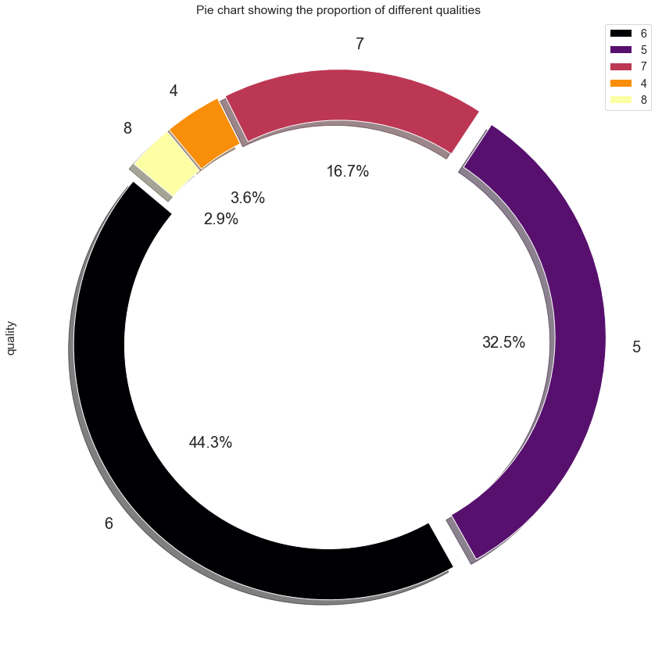
Exploratory Data Analysis-1
Proportion of various Wine qualities in data set.
Quality- 4 : 3.60 %
Quality- 5 : 32.50 %
Quality- 6 : 44.30 %
Quality- 7 : 16.70 %
Quality- 8 : 2.90 %

Slide 6
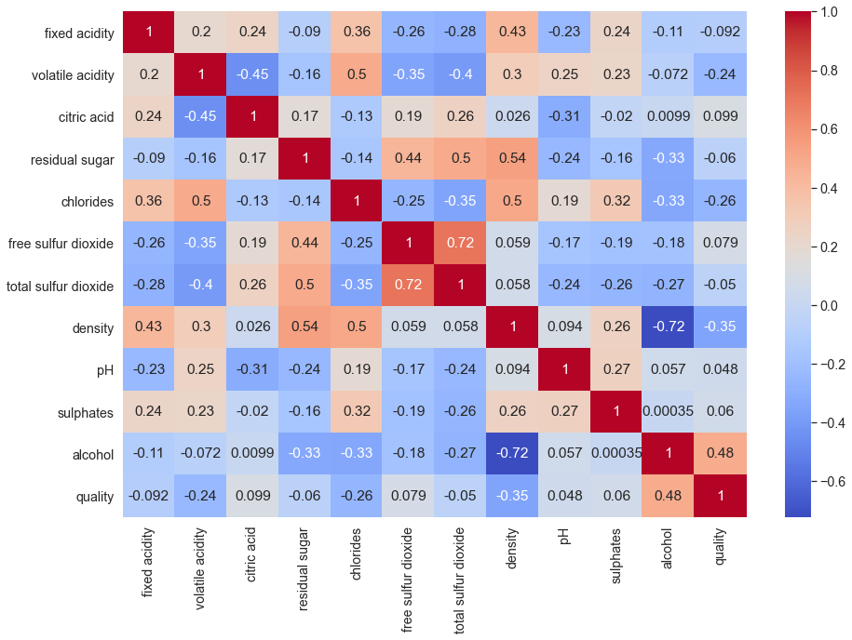
Exploratory Data Analysis-2
Heat Map showing correlations among parameters
S N | Top Correlated Parameters | Correlation
1 | Free Sulfur dioxide Vs Total sulfur dioxide | +0.72
2 | Residual sugar Vs Density | +0.54
3 | Residual sugar Vs Total sulfur dioxide | +0.50
4 | Volatile Acidity Vs Chloride | +0.50
5 | Alcohol Vs Quality | +0.48
6 | Residual sugar Vs free sulfur dioxide | +0.44
7 | Fixed Acidity Vs Density | +0.43
8 | Fixed Acidity Vs chlorides | +0.36
9 | Chlorides Vs Sulphates | +0.32

Slide 7
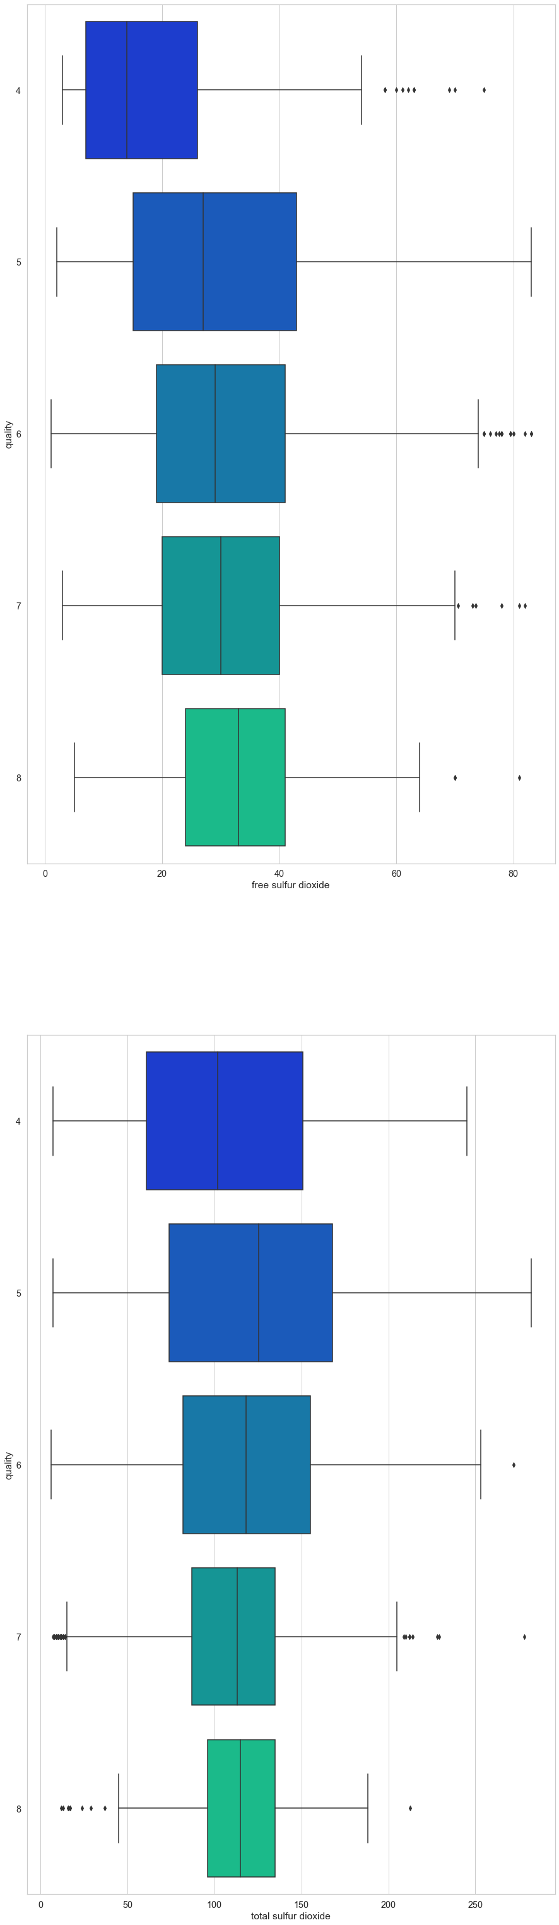
EDA-3
Quality of Wine w.r.t. ‘Free Sulfur Dioxide', & ‘Total Sulfur Dioxide‘

Slide 8
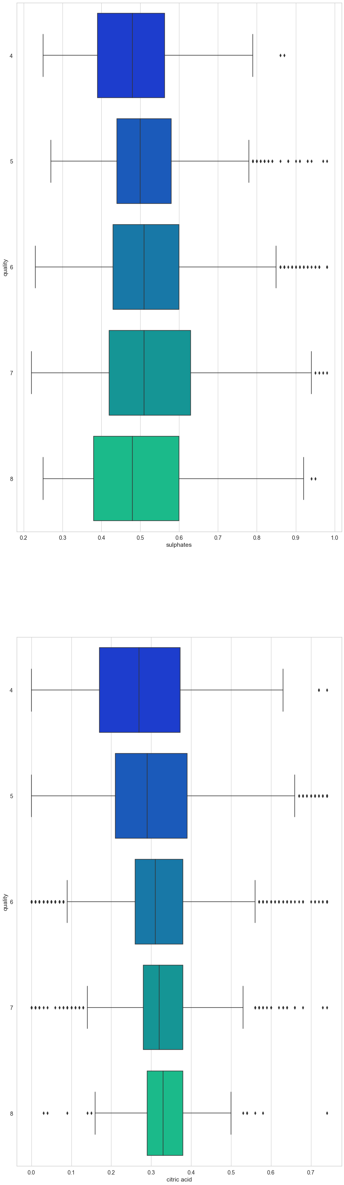
EDA-4
Quality of Wine w.r.t. ‘Sulphates', & ‘Citric acid'

Slide 9
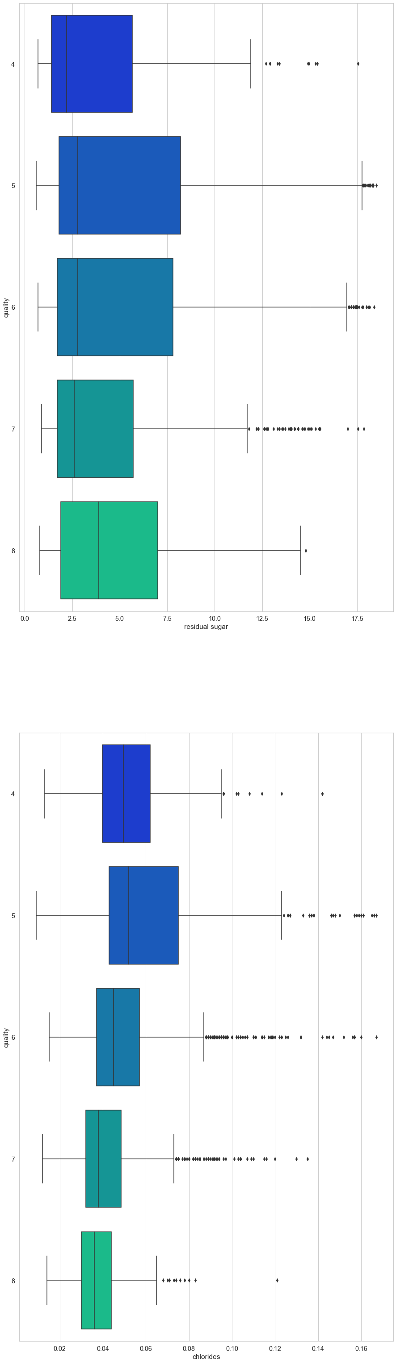
EDA-5
Quality of Wine w.r.t. ‘Residual Sugar', & ‘Chlorides

Slide 10
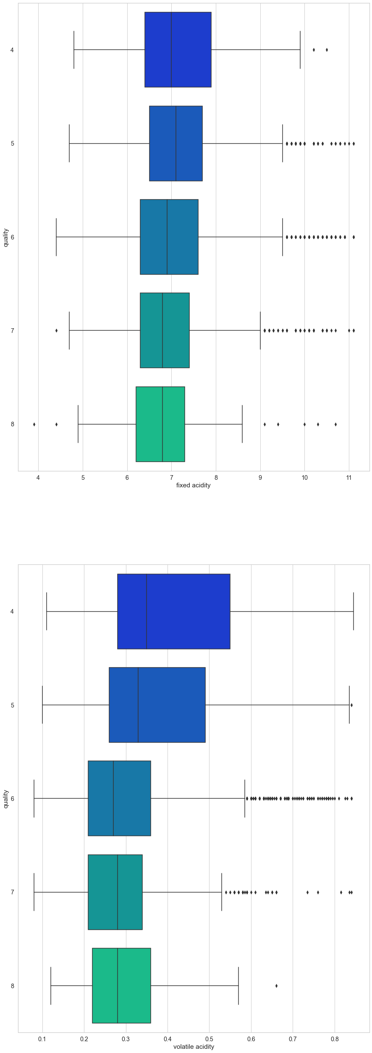
EDA-6
Quality of Wine w.r.t. ' Fixed Acidity', & ‘Volatile Acidity‘

Slide 11
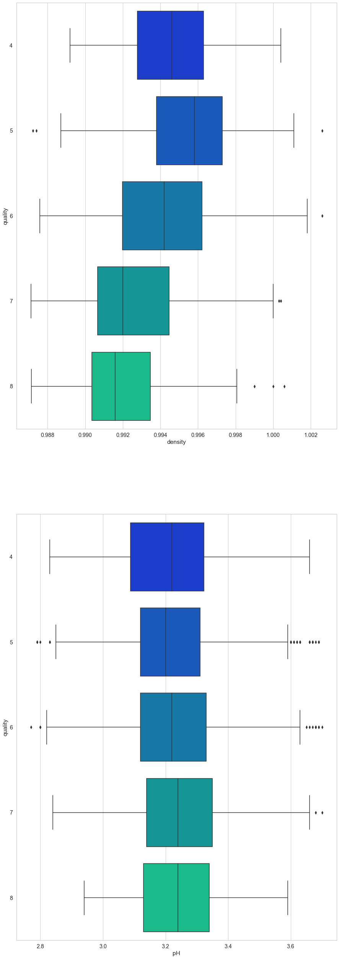
EDA-7
Quality of Wine w.r.t. ' Density', & ‘pH'

Slide 12
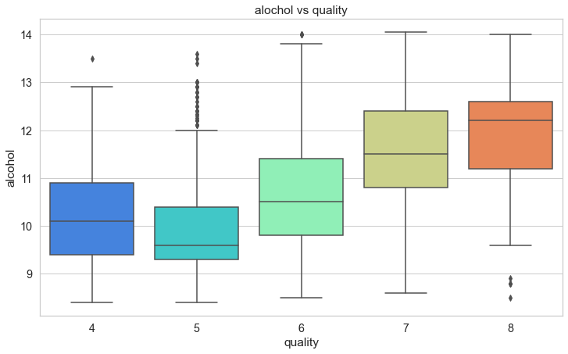
EDA-8
Quality of Wine w.r.t. ‘Alcohol’

Slide 13
Conclusions
Alcohol content, pH, Residual Sugar, Sulphates, Citric Acid, Free Sulfur dioxide, & Total Sulfur dioxide increases with increasing Wine quality scale(Positively Correlated Parameters)
Density, Volatile Acidity, Fixed Acidity, & Chlorides decreases with increasing Wine quality scale(Negatively Correlated Parameters)

Slide 14
Actionable Insights: To get higher quality Wine(6,7,8) following should be the range for parameters.
Following are positively correlated parameters & range is as below for getting higher quality wine.
Alcohol content- >10.5 & <12.2
pH- >3.24 & <3.26
Residual Sugar- >2.75 & <3.75
Sulphates- >0.48 & <0.51
Citric Acid- >0.31 & <0.33
Free Sulfur dioxide- >30 & <32
Total Sulfur dioxide- >115 & <120.
Following are negatively correlated parameters & range is as below for getting higher quality wine.
Density- <0.988 & >0.992
Volatile Acidity- <0.28 & >0.27
Fixed Acidity- <6.9 & >6.8
Chlorides- <0.043 & >0.038

